Slide 1
Instrument calibration

Slide 2
Calibration is the comparison of a measurement device (an unknown) against an equal or better standard.
Instrument calibration consists of comparing output of the instrument under test against output of an instrument of known accuracy when the same input is applied to both instruments.
This procedure is carried out for a range of inputs covering the whole measurement range of instrument.
It has to be repeated at prescribed intervals.

Slide 3
It ensures that measuring accuracy of all instruments is known over the whole measurement range .
The instrument used as a standard for this procedure must be one which is kept only for calibration duties .
The calibration function must be managed and executed in a professional manner .
This means setting aside a particular place within the instrumentation department where all calibration operations take place and where all instruments used for calibration are kept.

Slide 4
Sometimes it is not possible to remove instruments from process plant and in these cases it is standard practice to calibrate them in situ.
The performance of all calibration operations is assigned as the clear responsibility of just one person.
The person should have total control over the calibration function .
All persons using the calibration equipment must be adequately trained

Slide 5
Maintaining proper records is an important part of fulfilling calibration function
This record should start by giving a description of the instrument followed by what the required calibration frequency is.
Each occasion when the instrument is calibrated should be recorded

Slide 6
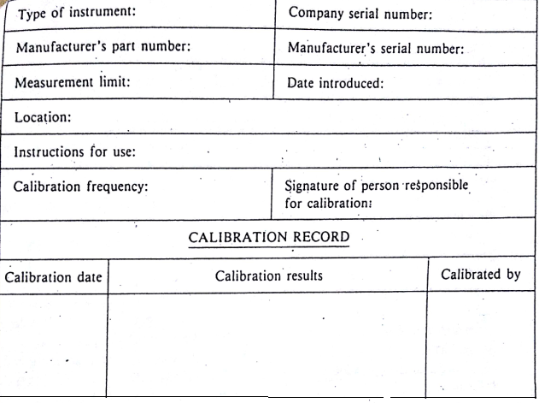

Slide 7
Traceability
Calibration has a chain like structure in which every instrument is calibrated against a more accurate instrument immediately above in the chain.
This knowledge of the full chain of instruments involved in the calibration procedure is known as traceability

Slide 8
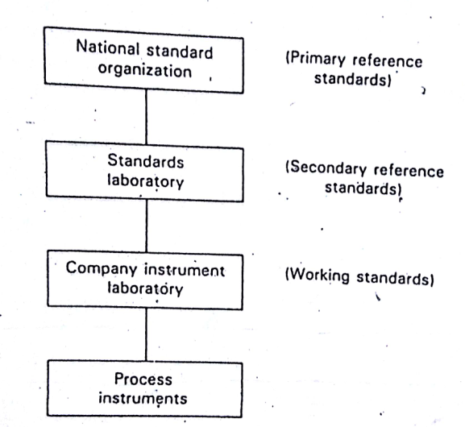
Instrument Calibration Chain

Slide 9
